Slide 1

Samuel M. Gantner School
Lodi USD Team:
Edith Holbert, Joe Patty, and Desiree Wise
HMC Architectural Team:
Jeffrey Grau and Jennifer Huang
May 6, 2025

Slide 2

Executive Summary
Purpose of Educational Specifications (Ed Specs)
  Educational specifications are statements that clearly communicate what educators require from a proposed facility to support a specific academic program.
  Serve as the link between the educational program and the school facilities.
  By describing the activities and space requirements, they guide architects in creating environments that enhance teaching and learning.
Next Steps
  The project team seeks Board input to confirm the report meets expectations and to receive guidance on returning the report for approval.

Slide 3

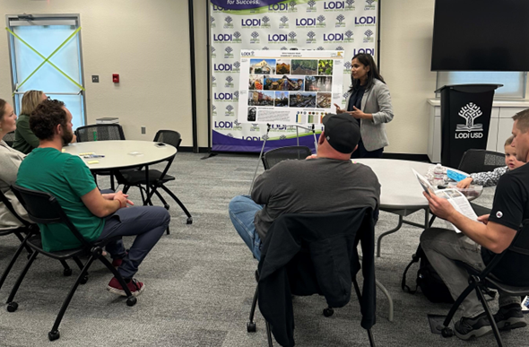
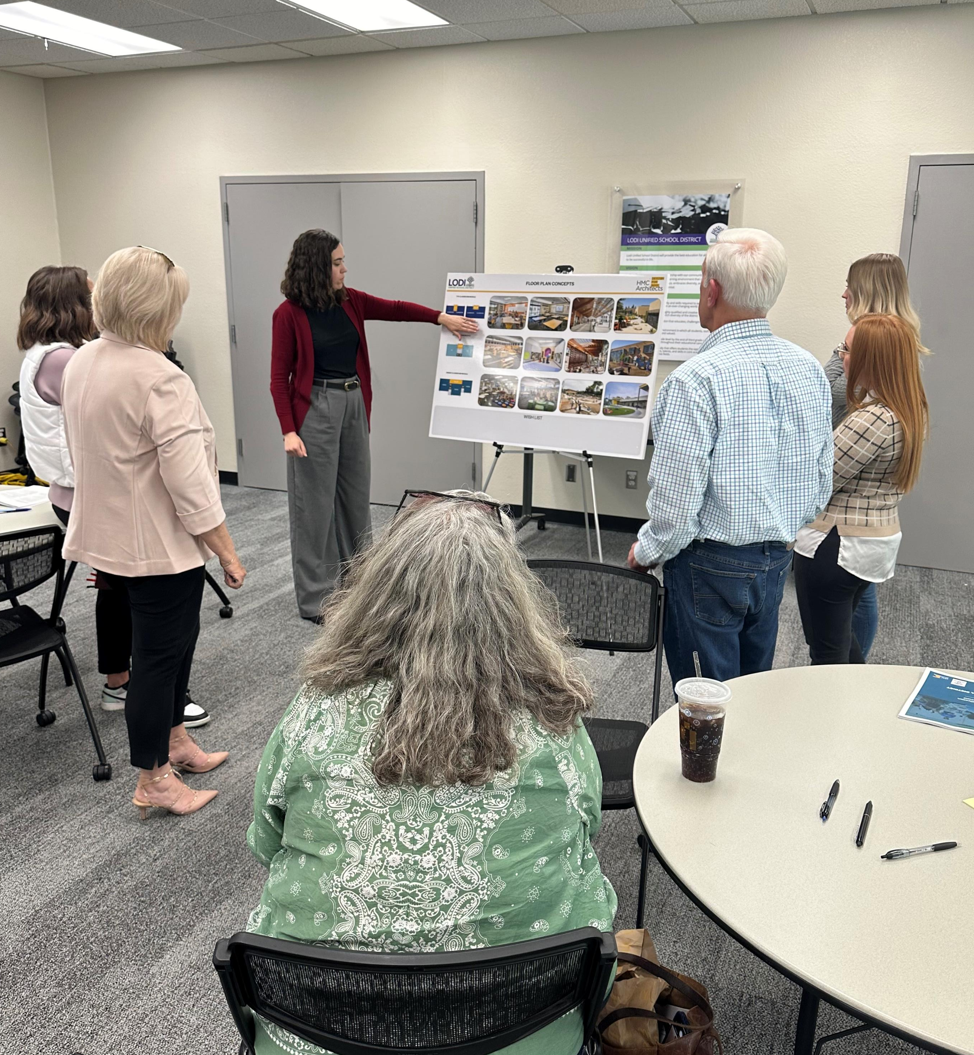
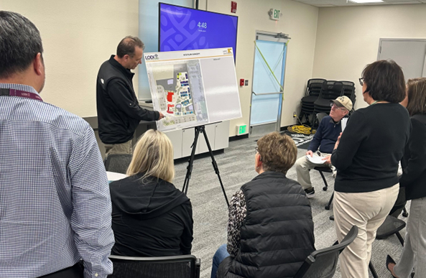
Collaborative Input
  Long Range Master Plan (Board Approved January 2024)
  Collaboration with District Educational Services, Facilities Team, and Board Architects
Stakeholder Engagement (Teachers, Administrators, and Community Members)
  Student Input – Thank you Larson Stars!

Slide 4
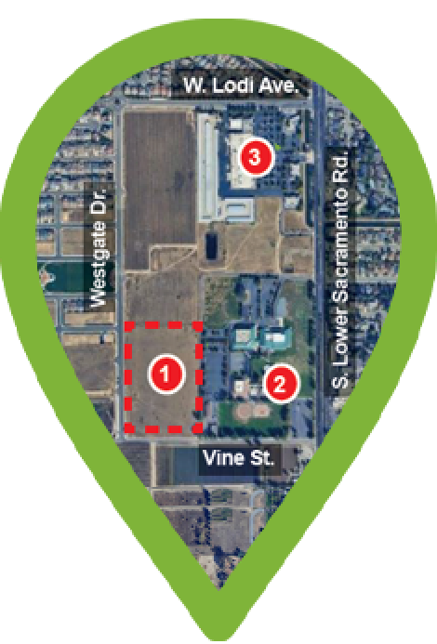
Planning Considerations
Grade Configuration
Phasing
Primary focus on TK–6, with design for a full TK–8 configuration, if necessary.
Accommodate varied grade-level groupings as district needs change.
Flexible layout supports a phased implementation strategy.
Designed for long-term adaptability in both function and enrollment capacity.
Facility may be built in phases based on available funding.
Phasing strategy integrated into planning and design.
Initial phase will support full functionality as a standalone school.
Future additions can be made with minimal disruption to operations.
Phase 1 capacity: approximately 450 students.
Site - 11.5 acres, located at Vine and Westgate.
Capacity - 650 for TK-6th / 850 for TK-8, if necessary.
The design can be modified for use on other district properties.

Slide 5
Key Concepts Driving the Facility Design
Flexibility
Adaptable learning spaces that support varied group sizes and changing educational needs.
Outdoor Learning
Integrate outdoor spaces to enhance student learning well-being through nature.
Connection
  Shared and outdoor spaces to foster a sense of belonging and collaboration
Technology
  Infrastructure to support evolving digital learning, mobile-friendly spaces, and flexible environments.
Safety + Security
  Secure, welcoming environment with a single-entry point and strong visibility.
Transparency
  Design to promote openness through visibility, while minimizing distractions.
Sustainability & Energy Efficiency
  Maximize natural daylight, utilize all-electric systems, solar energy, and utilize materials that reflect a commitment to environmental responsibility.

Slide 6
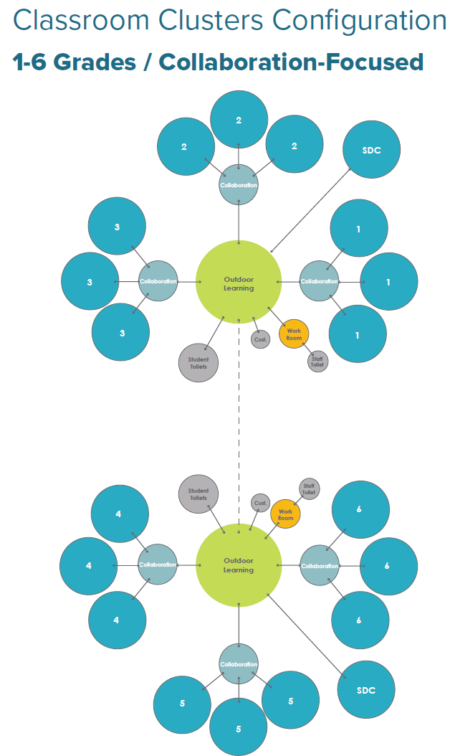
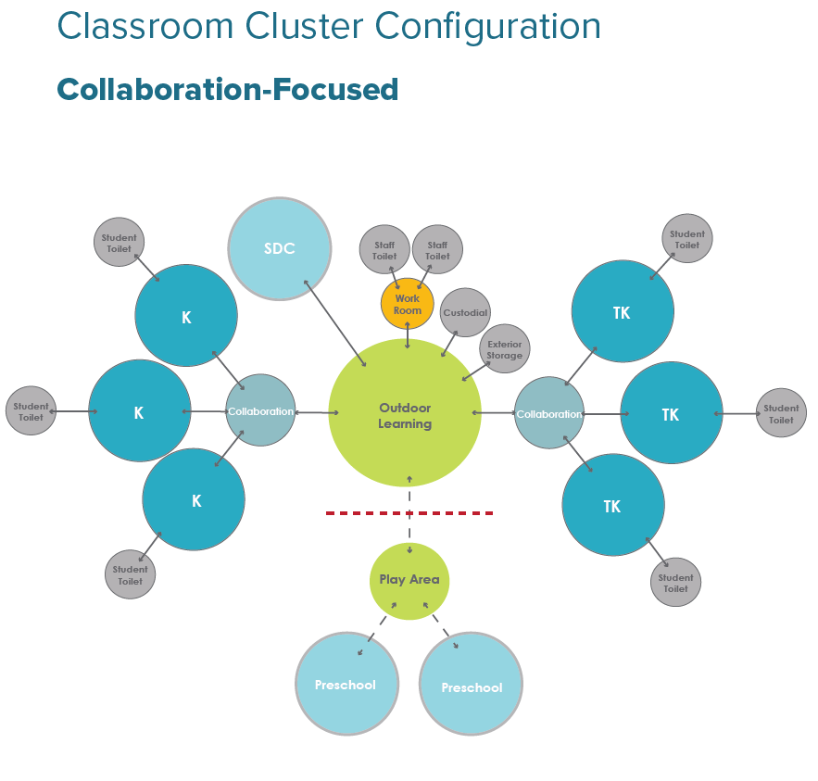
Key Design Elements
Classroom Cluster Configuration
Clusters are flexible to accommodate rotating single subject or self-contained multiple subject structure. Phased construction can allow for incremental growth of students, if necessary.

Slide 7
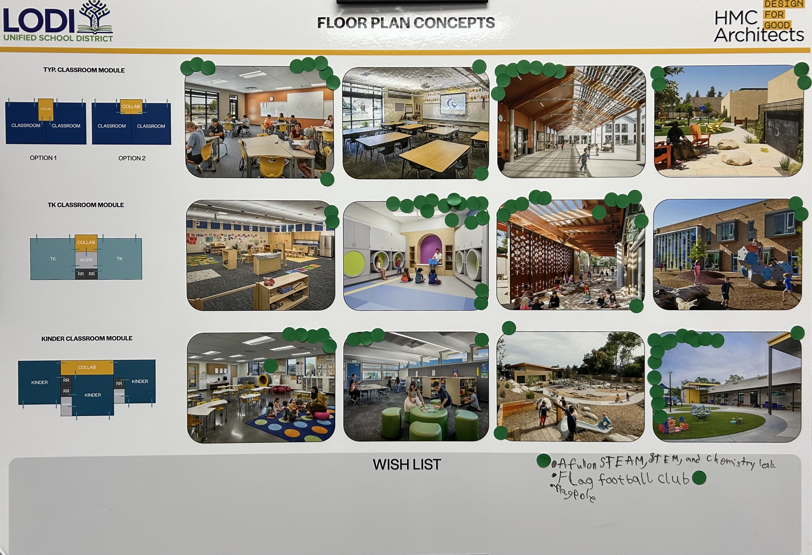
Key Design Elements
General
Prioritize flexible, adaptable spaces.
Combine mobile furniture with built-in storage.
Durable hard surfaces; walk off mat at entrances & under sinks.
Include a sink in every classroom.
Backpack storage needed at all grade levels.
Staff collaboration spaces within clusters.
Strong tech infrastructure with ample device charging.
Collaboration Space
Pull out space gives the ability to work with smaller groups on various tasks.
All grade levels will benefit from adjacent collaboration flex space.
Visual observation into small group areas.
Outside Learning
Access to an outdoor gathering space is beneficial.
A strong connection to the exterior and natural environment should be incorporated into outdoor learning opportunities.
This is a representative sample; full details are provided in the
Ed Specs.

Slide 8


