Slide 1

Student Achievement
Dr. David Horton, Associate Superintendent
Educational Services
&
Uve Dahmen, Program Coordinator
Assessment, Research, and Evaluation
October 1, 2024

Slide 2

Executive Summary
“The Rear View Mirror” Data
CAASPP ELA and Math 3-year comparison study
UC/CSU a-g comparison study
AP test result comparison study – including Socio-Economically Disadvantaged discussion
“The Windshield” Data
The Formative Assessment Process – Visible Learning

Slide 3
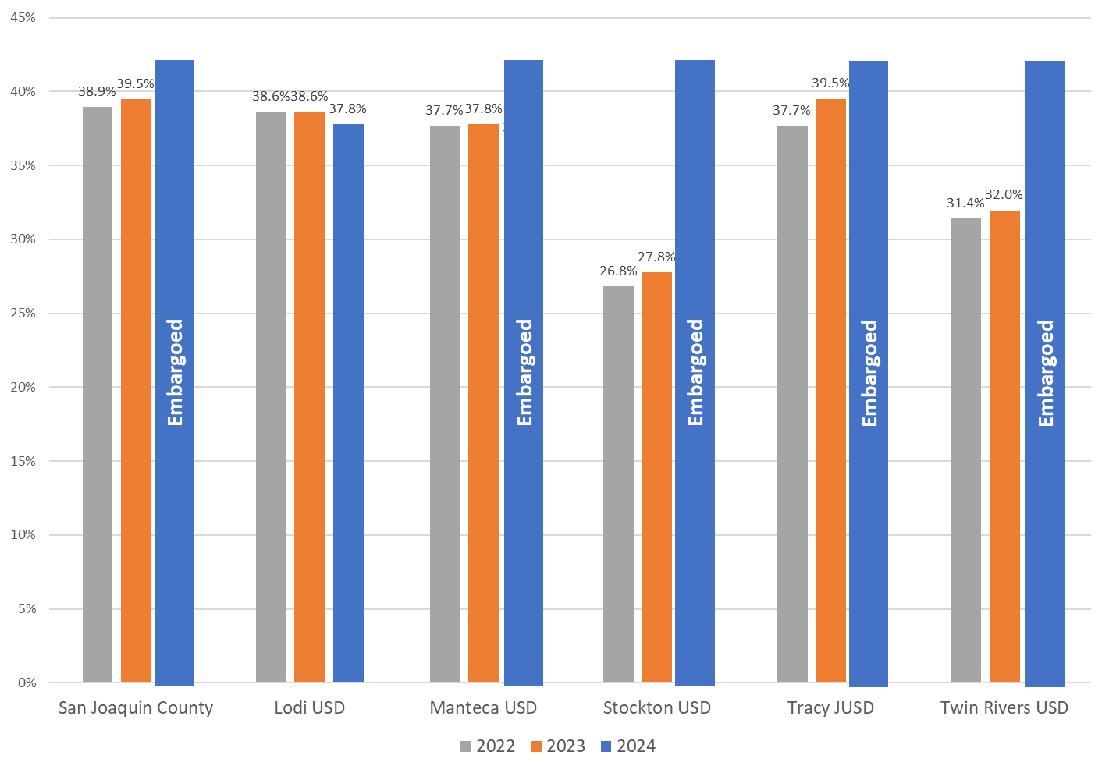
CAASPP ELA Standard Met or Exceeded Percentage: 2022-2024

Slide 4
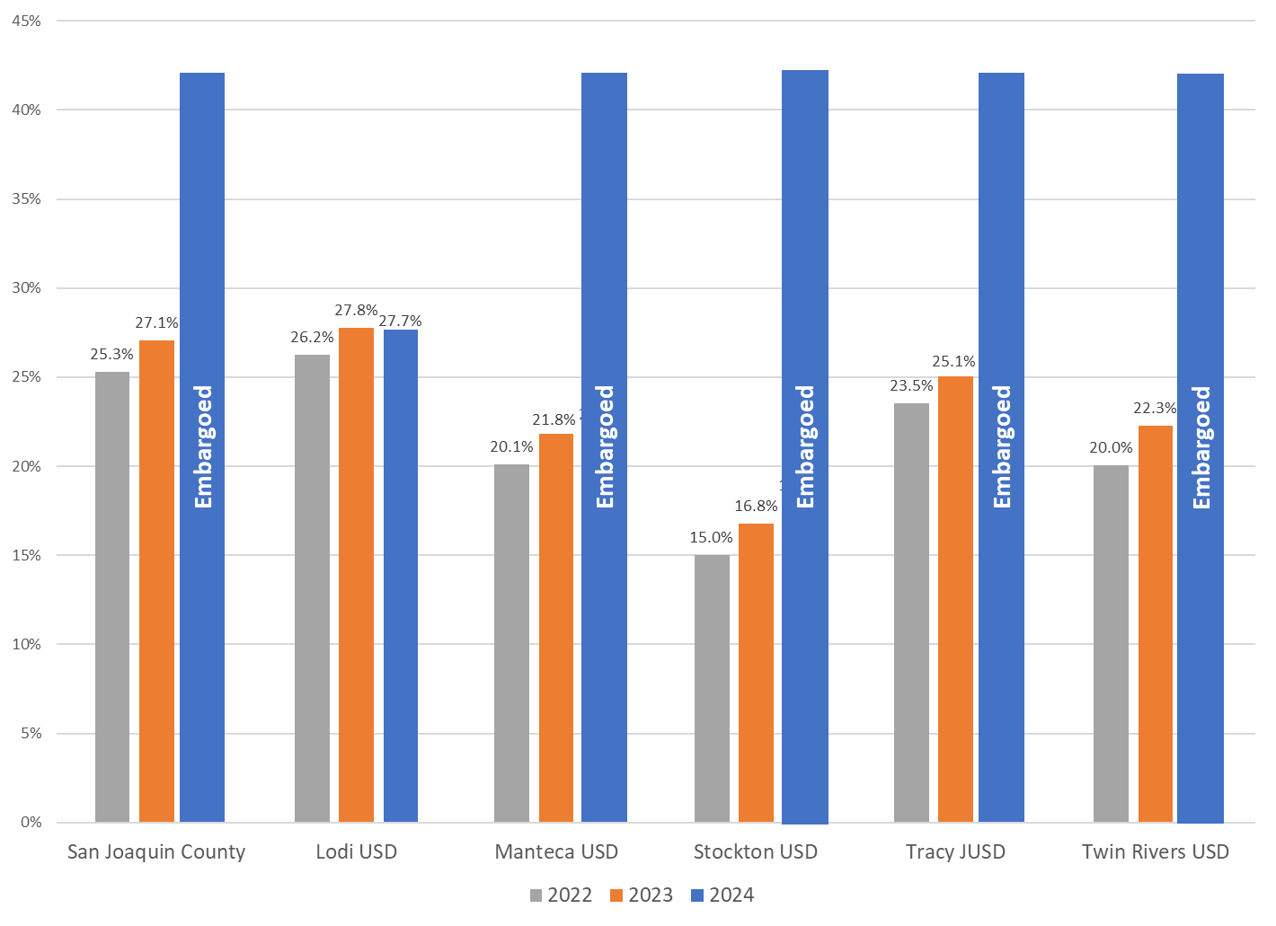
CAASPP Math Standard Met or Exceeded Percentage: 2022-2024

Slide 5
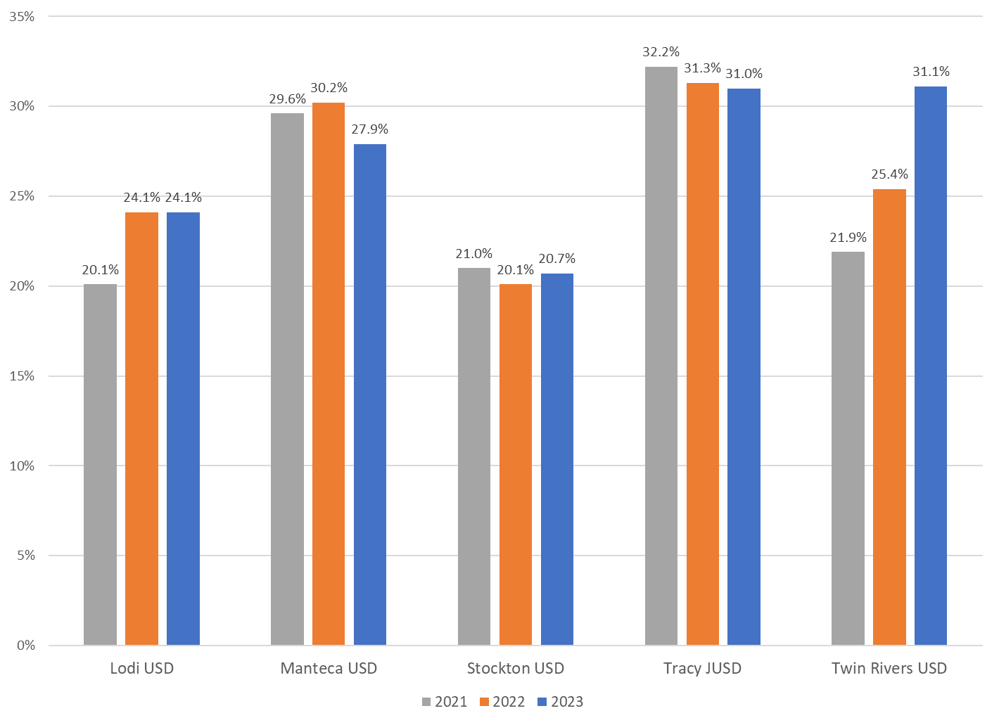
Percentage of Students Graduating with
A-G (UC/CSU) Requirements Met: 2021-2023

Slide 6
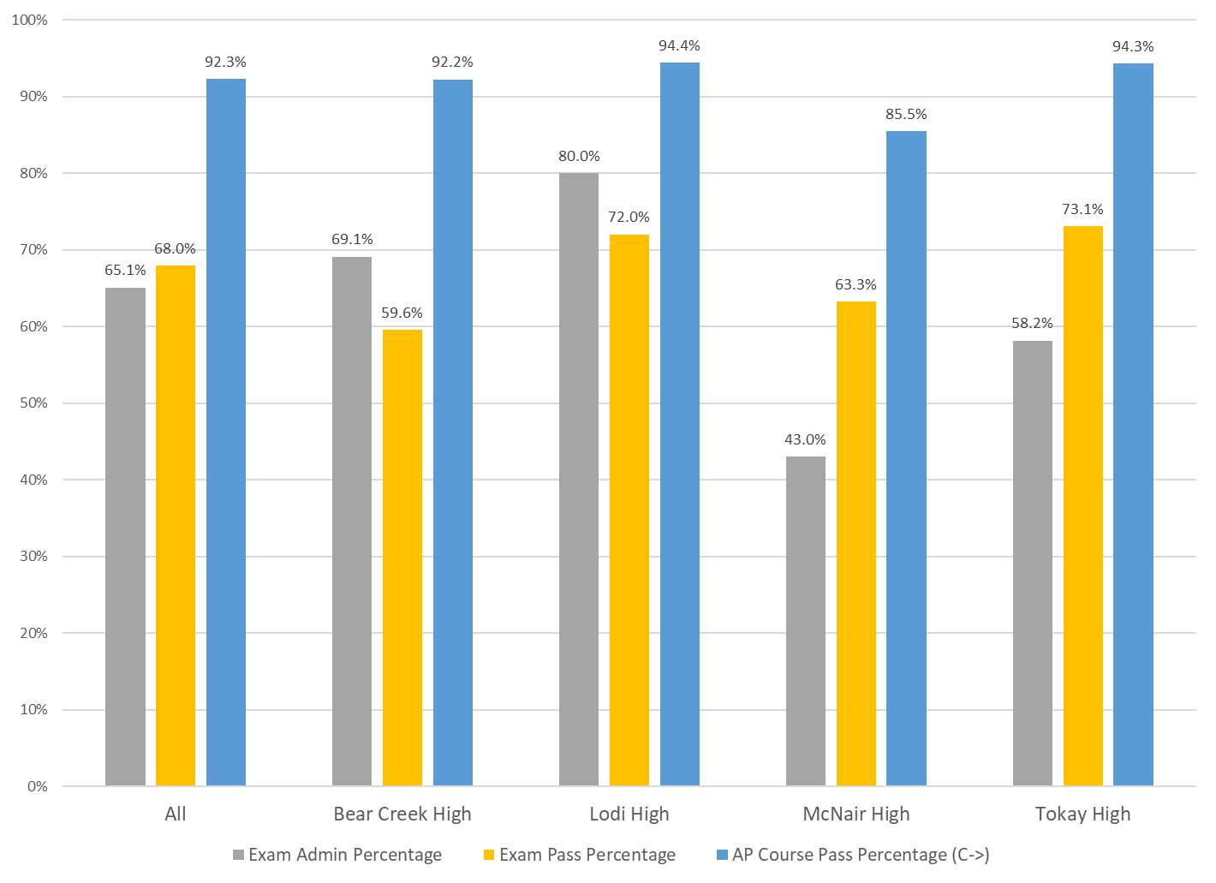
Advanced Placement Overview
Comprehensive High Schools: 2024

Slide 7
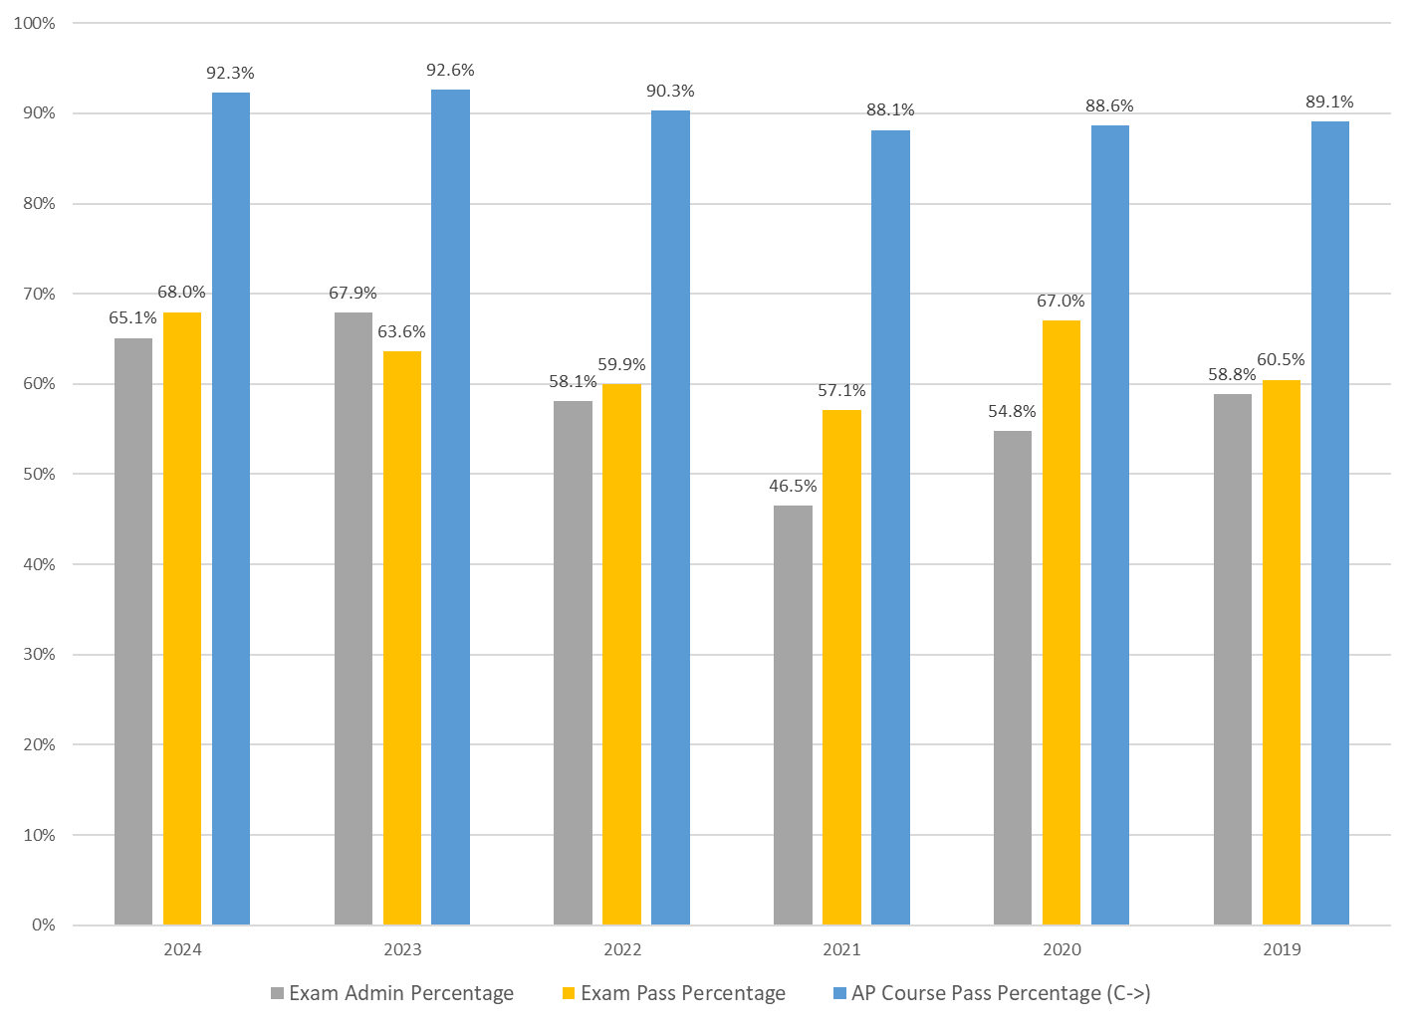
Advanced Placement Districtwide Overview: 2019-2024

Slide 8
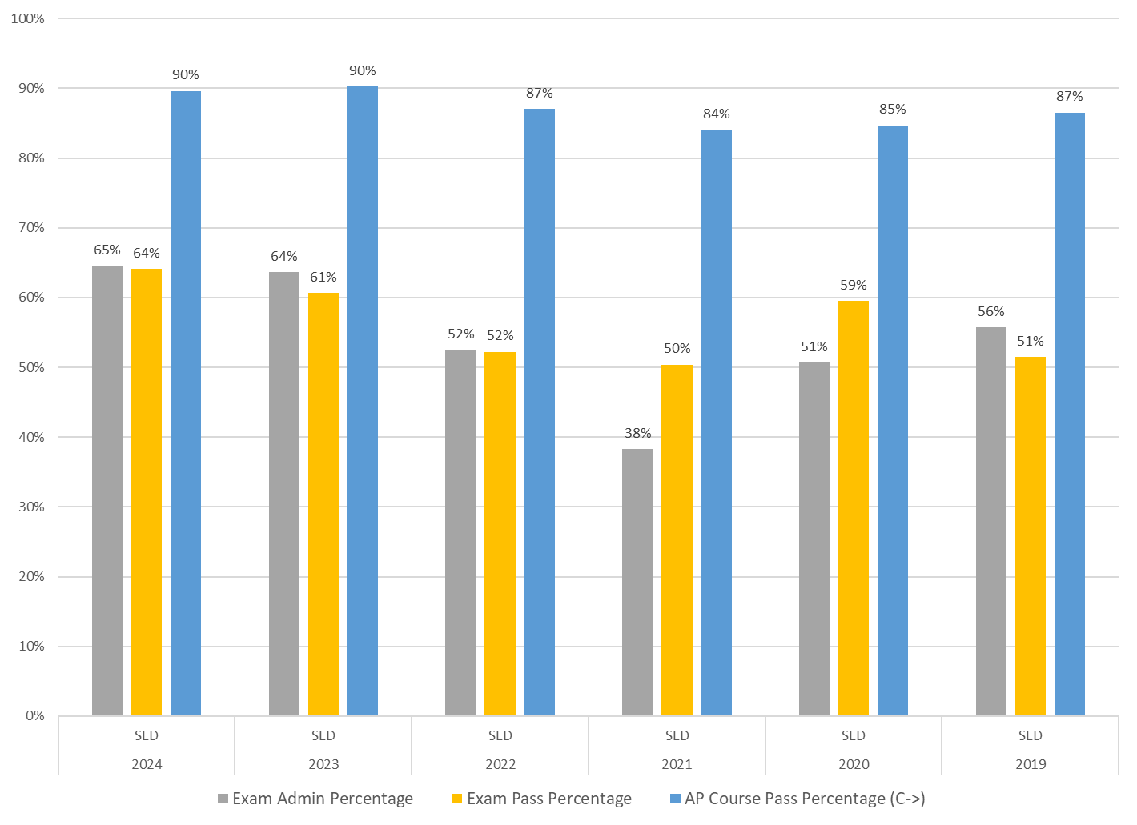
Socioeconomically Disadvantaged (SED) Advanced Placement Overview: 2019-2024

Slide 9
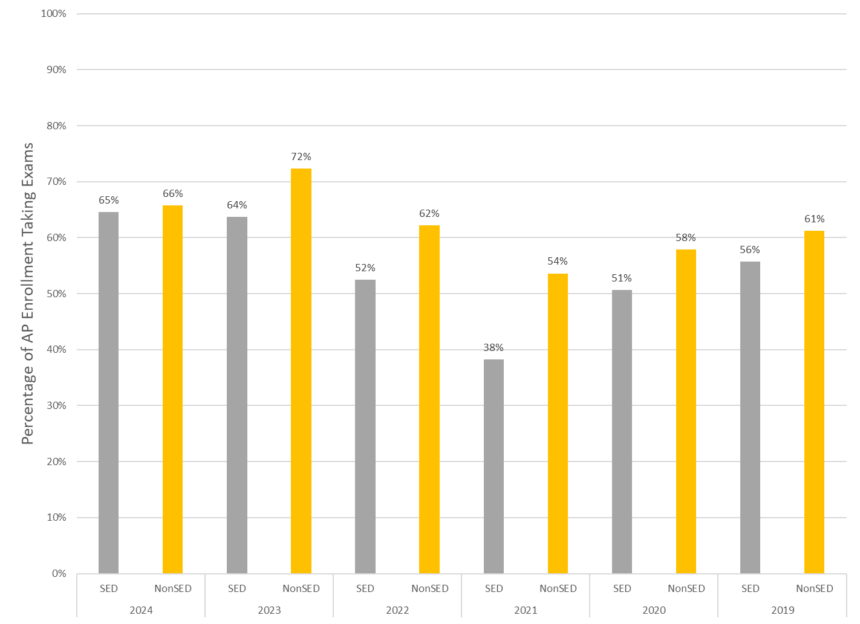
Socioeconomically Disadvantaged (SED) Status Comparison: 2019-2024

Slide 10
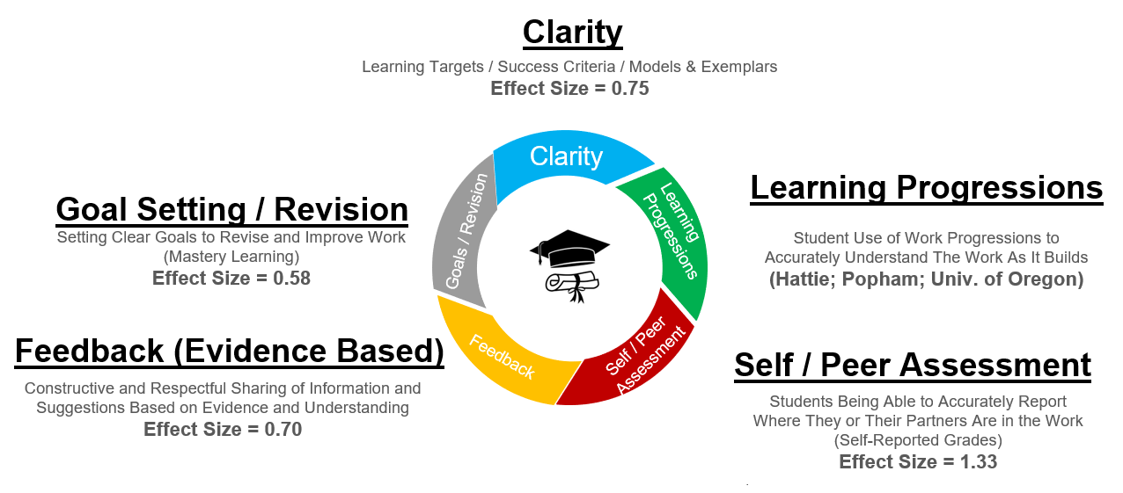
The Formative Assessment Process

Slide 11
Context
Ontario, Canada
Writing Workshop
Kindergarten
  Self Assessment
  Writing Progression

Slide 12

Kindergarten • Writing
• Learning Progressions • Self Assessment
Notes:
After video, simply ask:
Does she know where she’s going?
Does she know where she is in the process?
Does she know what her next steps are?
Sarah is an ASSESSMENT CAPABLE LEARNER…

Slide 13
Next Steps
Questions / Comments
Study Session – October 29

Slide 14


