Slide 1

Foster Youth & Homeless Education
Ben Rechter, Program Coordinator, CWA & Foster Youth District Liaison
Kelly Collins, Program Coordinator, Area 1 & Homeless District Liaison
October 15, 2024

Slide 2

Executive Summary
Highlight key programs, services, strengths, and challenges related to Foster Youth and Homeless Education in the Lodi Unified School District (LUSD).

Slide 3
Foster and Homeless Youth Defined
In California schools, Foster Youth and Homeless Youth (McKinney-Vento eligible) are two distinct groups of students, though they both face significant challenges and are provided special protections and services under the law.
Foster Youth: Is generally a child or youth a court has taken jurisdiction over due to…
The presence or risk of abuse or neglect.
The child or youth’s violation of certain criminal laws.
OR…
Is a child or youth who is the subject of a voluntary placement agreement
Homeless Youth: lack a fixed, regular, and adequate nighttime residence. They are protected under the McKinney-Vento Homeless Assistance Act.
Examples include: shelters, motels, campgrounds, cars, or temporarily doubled up with other families due to economic hardship or loss of housing

Slide 4

Foster Youth Program
Foster Youth Program:
  Legal Framework: Ensures immediate school enrollment, transportation, and school stability despite frequent placement changes.
  Challenges: High mobility leading to disruptions, emotional strain, absenteeism, and lack of resources.
  Services: Transportation, school supplies, emotional and academic support
  Success Stories: Partnerships with local organizations and direct student support have resulted in improved outcomes, such as graduation success and recognition by county educational authorities.

Slide 5
LUSD Foster Youth Outreach Team
Foster Team | Responsibilities
Program Coordinator/District Liaison Ben Rechter | Oversees the district-wide Foster youth program and ensuring compliance
Community Liaison Assistant Sandra Salazar | Acts as a point of contact between schools and homeless families. Provides support with enrollment and attendance issues. Sets up transportation as needed Connects families and students with basic needs & community resources.
Community Liaison Assistant Christopher Hernandez Merito | Acts as a point of contact between schools and homeless families. Provides support with enrollment and attendance issues. Sets up transportation as needed Connects families and students with basic needs & community resources.

Slide 6


McKinney- Vento Program for Students Experiencing Homelessness
McKinney-Vento Program for Students Experiencing Homelessness:
  Legal Framework: Guarantees rights such as immediate enrollment, transportation to the school of origin, and access to educational services.
  Challenges: Students face housing instability, poverty, absenteeism, and emotional strain.
  Services: Provision of school supplies, hygiene kits, transportation, and emotional and academic support.
  Team Collaboration: Program staff provide comprehensive support for students, collaborating with school and community resources, conducting staff training, and working together to ensure compliance with the McKinney-Vento Homeless Assistance Act.

Slide 7
McKinney- Vento Program Outreach Team
Homeless Education Team | Responsibilities
Program Coordinator/District Liaison Kelly Collins | Oversees the Lodi USD Homeless Education Program Ensures compliance with McKinney-Vento Act
Community Liaison Assistant Esther Grijalva | Connects families and students with basic needs & community resources Point of contact between schools and homeless families Provides support with enrollment and attendance Sets up transportation as needed
Teacher on Special Assignment Andrea Tetz | Provides individualized support, monitors academic progress and attendance Provides training to school staff on the needs of students experiencing homelessness Works closely with school counselors, administrators, teachers and other school staff to address the needs of homeless students
Counselors Victor Mariano & Alexis Suarez | Offers emotional and mental health support to homeless students. Provides guidance on college and career readiness. Assists with social-emotional learning and personal development.

Slide 8
Additional Information
Please note that the additional slides are included for your reference. We welcome any questions or discussions during the question-and-answer portion of the Board Report.

Slide 9

Foster Youth Outreach Team -
Lodi Unified School District

Slide 10
Supporting Foster Youth: Legal Framework, Services, and Challenges at Lodi USD
Legal Framework:
  Immediate Enrollment without typical documentation
  School Stability: Stay in the same school despite placement changes.
  Transportation to the school of origin.
Required Services:
  Transportation to maintain school attendance.
  School Supplies: Backpacks, hygiene kits etc.
  Emotional Support: Counseling and mental health services.
  Academic Support: Tutoring, after-school programs, IEP participation.
Main Challenges at Lodi USD:
  Frequent Moves: Leads to school disruptions and academic setbacks.
  Emotional and Psychological Strain: Trauma affects concentration and school performance.
  Resource Gaps: Limited access to basic needs like housing stability and supplies.
  Chronic Absenteeism: Instability makes regular school attendance difficult.
  Social Isolation: Stigma and lack of consistent adult advocacy.

Slide 11
Services Provided to Foster Youth
Transportation: Ensuring stability and consistent school attendance
School Supplies: Providing necessary academic materials and hygiene kits
Emotional and Mental Health Support: Counseling services for personal and academic guidance
Tutoring and After-School Programs: Enabling academic success
IEP Participation: Assisting with Individualized Education Plans for students with exceptional needs

Slide 12
Foster Youth Program Key Successes
Partnerships:
  Local Organizations (e.g., Kids Clothes Closet, CASA, SJCOE,)
  Connecting students and families to external resources for tutoring
Improvement Plans:
  Expanding outreach
  Implementing additional training for school staff
  Enhancing student engagement through new programs
  Increased supports aimed to increase graduation rates

Slide 13
Foster Youth Program Key Successes
Recognition
  Recognized at the Executive Advisory Council and Families in Transitions Liaisons meeting by the San Joaquin Office of Education for the second year in a row.
Community Partnership
  Collaborated with local nonprofit His Children’s Clothes Closet to assist foster youth in obtaining new and gently used clothing for school.
Graduation Support
  Two graduating seniors attending two different schools were gifted with caps and gowns, ensuring they could walk with their respective classes at graduation.

Slide 14
McKinney-Vento Program for Students Experiencing Homelessness

Slide 15
McKinney Vento Program for Students Experiencing Homelessness
Legal Framework (McKinney-Vento Act)
  Immediate Enrollment: Homeless youth have the right to enroll in school without typical documentation (birth certificates, proof of residency, etc.).
  Transportation: Students must be provided transportation to their “school of origin” to maintain stability.
  Access to Services: Schools must provide services to ensure academic stability and success.
Required Services
  Transportation to school
  School Supplies and meals
  Educational support
  District McKinney-Vento liaison to ensure rights are upheld
Main Challenges Faced by Homeless Youth
  Instability: Frequent moves and lack of permanent housing
  Poverty & Resource Gaps: Limited access to basic needs
  Chronic Absenteeism: Difficulty attending school regularly
  Emotional/Psychological Strain: Impact on mental health and ability to focus on schoolwork

Slide 16

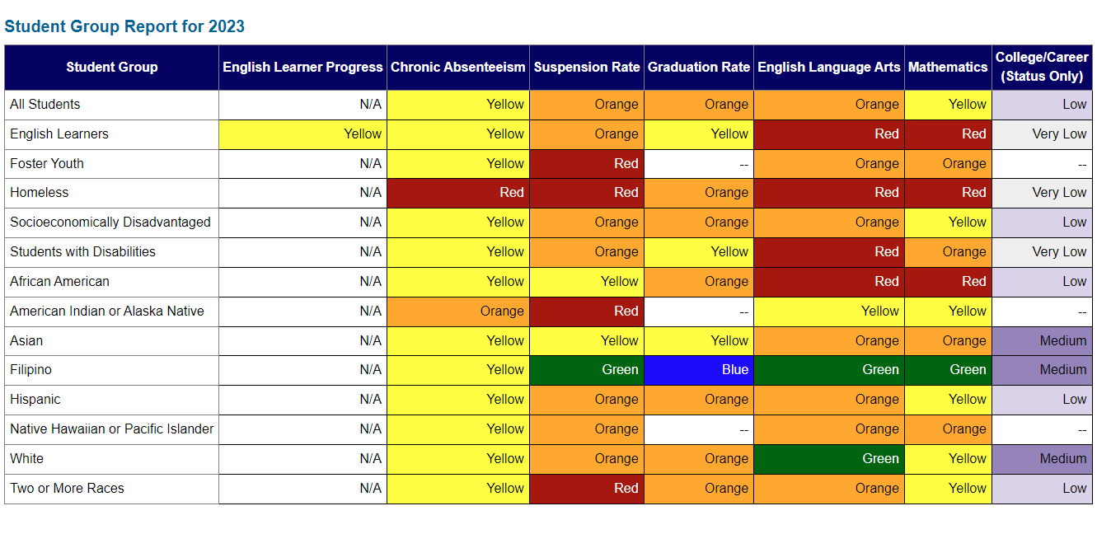
Impacts of Homelessness in LUSD
Lodi USD students experiencing homelessness are eligible for Differentiated Technical Assistance (DTA) due to low performance across the following state priorities:
CA Dashboard 2023

Slide 17

Homeless Education Supports
Community Liaison Assistant Support Examples
Assists site staff and with identification and enrollment
Assist CWA with home visits and enrollment
Process Intake forms and Maintains Case Load Lists
Family support: Referrals, Resources, District Supports
Provide: Emergency food, clothing, hygiene kits, school supplies,
Transportation: Bus Passes and District Transportation
Warm Handoffs and family check-ins
Notes:
Andie

Slide 18
Homeless Education Supports
Teacher on Special Assignment Support Examples
Provide students with backpacks, school supplies, hygiene kits
Outreach to “His Clothes” closet clothing donation service
Assist students in signing up for clubs, after-school tutoring, registration for Bridge
Provide bus passes
Connect w/parents regarding attendance to support Child Welfare & Attendance Advisor
Academic support
Participate in IEP meetings
Create plans for general success
Help obtain hotspots
Obtain tickets to events
Share trauma-informed resources with teaching staff
CAPC referrals
Attend staff meetings
Communication & encouragement
Notes:
Andie

Slide 19
Homeless Education Supports
Counseling Support Examples
Social Emotional Support: addressing concerns such as grief, self esteem, confidence, character development, self-regulation, positive & building positive peer relationships/friendships, and social transition for middle school students
Academic & Career Guidance: Discussing college and career plans to help them see a better future, FAFSA application support, providing resources for College Aid, and high school course planning support
Personal Needs Assistance: Ensuring students have the resources to succeed
Additional Support: A trusted adult that they can speak to and ask for help, creating a reliable support network
Notes:
Andie

Slide 20


