Slide 1




LCAP Update
By: Peter Lambert
Rafael Ceja
May 20, 2025
Educating Students for Success.

Slide 2

Executive Summary
  LCAP Update - Year 2 of 3-Year Cycle
  Provide Update Regarding Educational Partner Meetings
  Share How Educational Partner Input Shaped LCAP
  Provide Staff Recommendations
  Provide Learning Recovery Needs Assessment Recommendations
  Next Steps
  Questions

Slide 3
LCAP – YEAR 2 OF 3-YEAR CYCLE
The LCAP is a 3-Year plan
We are implementing year 1 of the 2024-27 plan
We must annually review and update the LCAP to reflect progress toward the goals
We complete an analysis of each goal reflecting on the implementation and effectiveness of actions
Based on analysis, consultation with Educational Partners and changes to LCAP instructions (ed code), minimal adjustments to existing actions and metrics are made
  LTEL is a new student group required to be added to metrics in 2025-26 plan

Slide 4
LCAP DEVELOPMENT AND ENGAGEMENT
LCAP
State and Local Data
LCAP Survey: Student and Parent Responses
Educational Partner Meetings
District & Site Leadership Meetings
Climate Survey: Student, Parent, and Staff Responses
DAC and DELAC

Slide 5
EDUCATIONAL PARTNER MEETINGS
Engaged teachers, principals, staff and students through targeted input meetings and surveys
Reviewed past goals, performance data, and draft initiatives for feedback
Outreach to employee groups and professional associations for collaboration
Notes:
Key achievements third bullet data is available on

Slide 6
EDUCATIONAL PARTNER MEETINGS
Gathered input from parents, students, and community via site councils and advisory committees (DELAC, DAC)
Distributed surveys and facilitated idea-sharing to capture diverse perspectives
  Increased participation through targeted outreach and short videos on social media
Provided translation at DELAC meetings to gather input from families of English learners

Slide 7
LREBG COMPREHENSIVE NEEDS ASSESSMENT ENGAGEMENT COMPONENTS
LREBG
State Data: Dashboard, CAASSP, DataQuest
District Plans: LCAP, CCEIS, DA
Local Data: DIBELS, i-Ready Math and Reading
LCAP Survey: Student and Parent Responses
WASC Review (Priority Need High Schools)
Leadership Interviews (Priority Need High Schools)
District Leadership Interviews
Climate Survey: Student and Parent Responses

Slide 8
FOUR DOMAINS COMPREHENSIVE NEEDS ASSESSMENT
ENGAGEMENT COMPONENTS
Title I Schools
SPSA Plans
CALL Survey
Classroom Visits
Site Leadership Interviews
Teacher Focus Groups
Staff Focus Groups
Local and State Site-Level Data

Slide 9
SELECTION OF PRIORITY NEED SCHOOLS
Priority need schools were selected using the following required Dashboard criteria: | Priority need student groups were selected using the following required Dashboard criteria:
Status of Very Low in ELA and Math indicator, Status of Very Low in ELA or Math and Very High on the K-8 Chronic Absenteeism indicator Status of Low or Very Low in ELA and Math and a decline or significant decline on at least two progress indicators from the prior year | Status of Very Low in ELA and Math Red dashboard indicator in either ELA or Math Red dashboard indicator in any area and a decline in status from the prior year

Slide 10
PRIORITY STUDENT GROUPS
Priority Student Groups ELA and Math | Priority Student Groups Chronic Absenteeism
African American American Indian/Alaskan Native English Learners Long-Term English Learners Students with Disabilities Foster Youth (Math) | American Indian/Alaskan Native Homeless

Slide 11
EXTRACTED THEMES: AREAS OF STRENGTH
Early Literacy Improvements: Progress in ELA at the elementary schools, especially in K-3 reading due to the district’s early literacy initiative and focus on phonics.
Innovative Instructional Practices: District and sight leaders are seeing positive responses teachers and progress in student learning and engagement through Visible Learning and Measuring Student Learning Project (MSLP) Professional Learning Communities (PLCs).
Increased use of data: Sites are using local assessments like DIBELS and i-Ready in combination with other formative assessments to monitoring student achievement throughout the year.
Family and Community Building Efforts: The district and sites have made concerted effort to engage families and the community which has helped improve school culture and building a stronger sense of community, so students want to attend school.
Improved Attendance: The district has seen a downward trend in chronic absenteeism, with no schools performing in red on the state dashboard.

Slide 12
FOUR DOMAINS: COMMON STRENGTHS
Community and Family Engagement: Many schools maintain strong relationships with families and create welcoming, inclusive environments.
Supportive and Safe Cultures: Schools prioritize removing barriers to learning and fostering belonging.
Staff Collaboration: Evidence of teacher collaboration is common, particularly through PLCs and shared responsibility for student outcomes.
Use of Data: Several schools are developing strong practices for using data to inform instruction and interventions.

Slide 13
EXTRACTED THEMES: AREAS FOR IMPROVEMENT
  Inconsistent Instructional Strategies: There is a lack of consistent implementation of effective instructional strategies across schools, leading to disparities in student outcomes.
  Need for Targeted Interventions: There is a critical need for timely and targeted support for English Language Learners (ELL) and Students with Disabilities (SWD) to address specific skill deficits among students, particularly in foundational literacy and math skills.
  Coordinated Professional Development: Need for coordinated and strategic alignment of professional development efforts, with a focus on curriculum delivery and teacher support.
  Data Utilization and Analysis: Better integration of data and qualitative insights to drive decision-making and resource allocation.
  Systematic Approaches Needed: The absence of systematic approaches for tracking and addressing specific learning gaps contributes to ongoing challenges in student achievement.

Slide 14
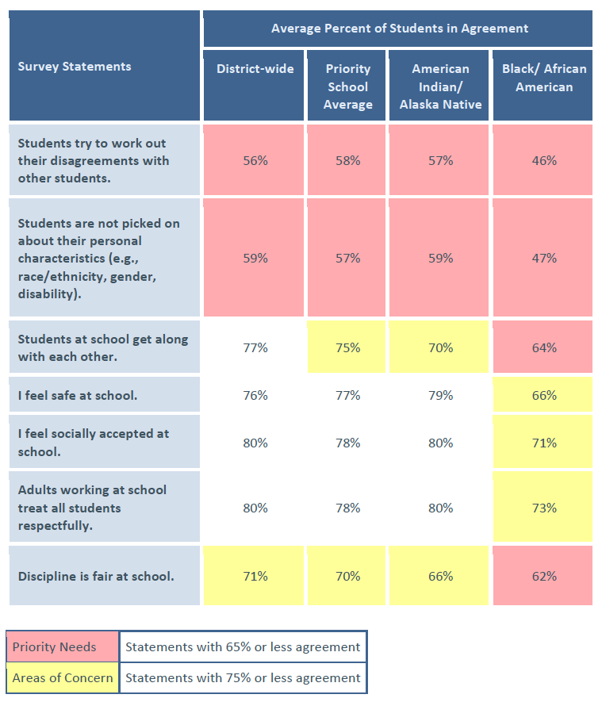
CLIMATE SURVEY RESULTS
District Climate Needs
Survey data indicates a need to better support students in resolving conflicts and addressing bias-based peer interactions.
Priority Student Group Needs
African American students report more negative experiences with peer interactions, safety, social acceptance, and treatment by adults.
American Indian/Alaska Native students report similar overall experiences to district averages but note concerns with peer relationships and fairness in discipline.

Slide 15
FOUR DOMAINS: PRIORITY NEEDS ACROSS SCHOOLS
Rigorous, Evidence-Based Instruction: Many schools are working to strengthen Tier 1 instruction and better align teaching with academic standards.
Professional Development: Schools are identifying a need for more targeted, differentiated PD that addresses specific instructional priorities.
Monitoring and Goal-Setting: Some schools are seeking more effective systems to track progress and align instructional strategies with goals.
Family Engagement in Academics: While many schools have welcoming cultures, there is growing interest in fostering deeper family partnerships in academic learning and decision-making.

Slide 16
HOW THE FOUR DOMAINS WORK ALIGNS WITH LREBG NEEDS ASSESSMENT
LREBG Barriers to Success | Aligned Four Domains Practice | Evidence in Our Data
Align instructional practices across classrooms | 3.2 Provide rigorous, evidence-based instruction | Instructional rigor insights (CALL 3.2)
Expand targeted support for ELL and SWD | 3.3 Remove barriers and provide opportunities | Root cause analysis findings
Streamline and align professional learning | 2.2 Target professional learning opportunities | PD alignment opportunities (CALL 2.2)
Strengthen goal-setting and progress monitoring | 1.2 Monitor short- and long-term goals | Priority growth practice
Foster inclusive, affirming school climates | 4.1 Build a culture focused on student learning and effort | CNA focus group input, CALL data
Deepen family partnerships in academics | 4.3 Engage families in pursuing academic goals | CNA focus group input, CALL data

Slide 17
HOW PARTNER INPUT SHAPED LCAP ACTIONS
Reviewed feedback to identify key themes and community priorities
Incorporated new or expanded strategies (for example, intervention, technology, mental health) where resources allow
Ensured final plan reflects community needs and aligns with district goals and budget constraints

Slide 18
LCAP RECOMMENDATIONS
Lodi USD Staff recommends:
  Continue current LCAP actions
    Including actions to address class sizes
    Maintain supplemental staffing to support school sites
    Provide targeted professional development in core academic areas
  Consider recommendations for additional resources and supports on the next slide

Slide 19
LCAP RECOMMENDATIONS
Lodi USD Staff recommends:
  Expand student enrichment and intervention supports and resources
  Support College and Career readiness initiatives
  Enhance school safety measures
  Strengthen student well-being and health support
  Ensure adequate facilities and custodial support
  Increase parent and family engagement efforts

Slide 20
NEXT STEPS – 2025-2026 LCAP DEVELOPMENT
Finalize draft LCAP based on educational partner input and Board study session feedback
Post draft for public review at District Advisory Council and District English Learner Advisory Council meetings
Hold required public hearing on June 3
Present final LCAP for Board adoption on June 17
Submit Board adopted to LCAP to SJCOE for approval
Share adopted plan with educational partners and prepare for implementation beginning July 1

Slide 21

QUESTIONS
Do you have any questions about the LCAP Update for Year 2 of the 3-Year Cycle?

Slide 22


